Slide 1
UBER TRIPS ANALYSIS Group-21
Akshi Gupta
Amol Agarwal
Astha Garg
Unnati Soni

Slide 2
UBER TRIPS ANALYSIS
Uber has been a major source of travel for people living in urban areas. Some people don’t have their vehicles while some don’t drive their vehicles intentionally because of their busy schedule. We can say that different kinds of people are using the services of Uber and other are using the taxi services, according to their situation and requirement.
So, now we will take you through Uber trips analysis using Python.

Slide 3
UBER TRIPS ANALYSIS
By analyzing Uber trips, we can draw many patterns like which day has the highest and the lowest trips or the busiest hour for Uber and many other different types of patterns. The dataset we will be using here is based on Uber trips from New York, a city with a very complex transportation system with a large residential community.
The dataset contains data of about 4.5 million uber pickups in New York City from April to September and 14.3 million pickups from January to June 2015.
Let’s now analyze the dataset and we will see what different patterns can be drawn and how can we draw the dataset.

Slide 4

Libraries that we used for Analysis

Slide 5
DATASET
https://github.com/amankharwal/Website-data/raw/master/uber-raw-data-sep14.csv.zip

Slide 6
This above link takes you to the dataset that we had used.
This data contains four columns i.e. data about “Date and Time”, “Latitude and Longitude” and a “Base” column that contains code affiliated with the uber pickup. You can get more datasets for the task of Uber trips analysis from here, as there are lots of different datasets available for uber trips analysis. For now, let’s prepare the data that we are using here to analyze the Uber trips.

Slide 7
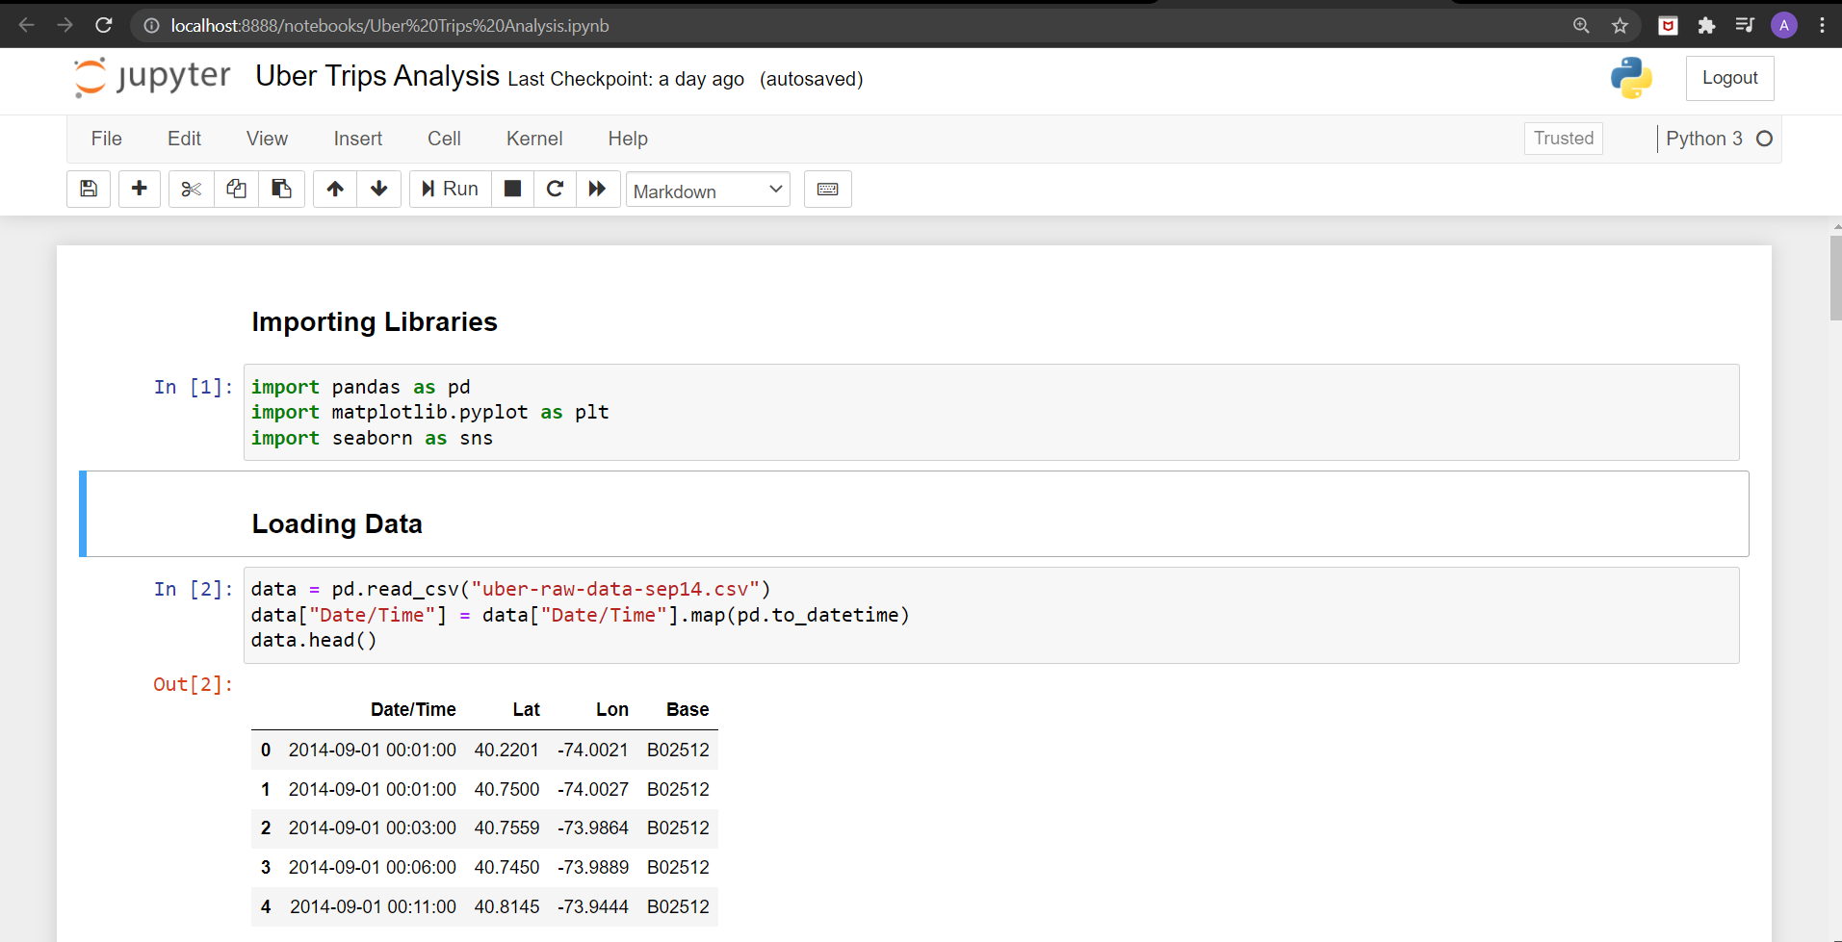
We import all the required libraries for visualization and then load the dataset and view it.

Slide 8
Firstly, we will analyze the Uber Trips according to “days and hours” i.e. by using first column.
So we prepared the data according to the days and hours, as we are using the Uber trips for the September month so let’s have a look at each day to see on which day the Uber trips were highest. Also let’s analyze that on which day uber trips were lowest by using visualization techniques:

Slide 9
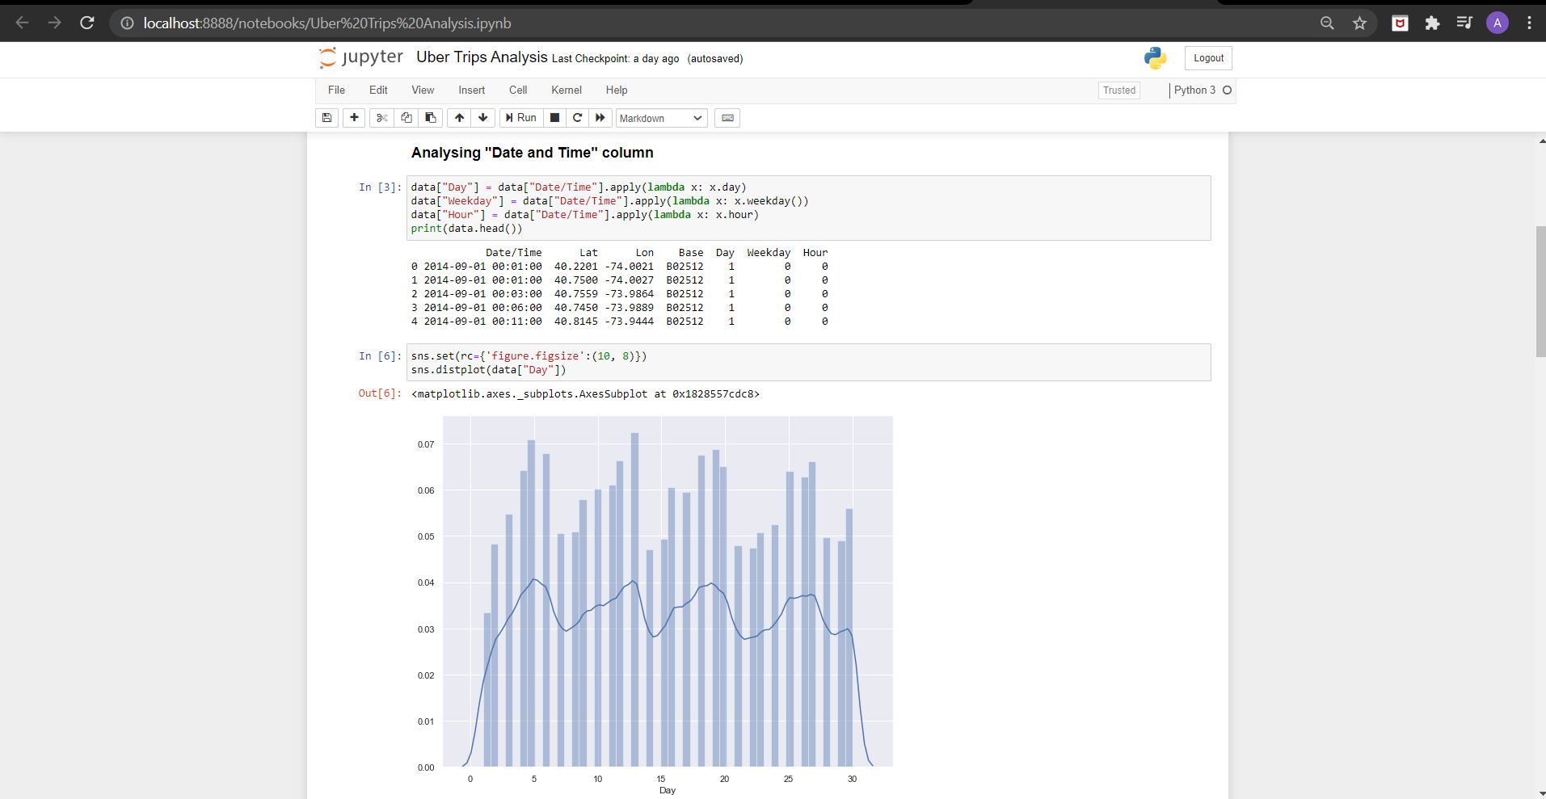
Analyze the Uber Trips according to “days and hours”
Rising on working days and Decreases on the weekends

Slide 10
By looking at the daily trips we can say that the Uber trips are rising on the working days i.e. Ubers are used more from Monday to Friday and it is also very obvious that people will use uber when they have to go for work. And Uber trips decreases on the weekends i.e. Saturday and Sunday as these days are not working days so people will not use uber at that much extent.
Now let’s analyze the Uber trips according to the hours and see the variation in uber use on the basis of hours:

Slide 11
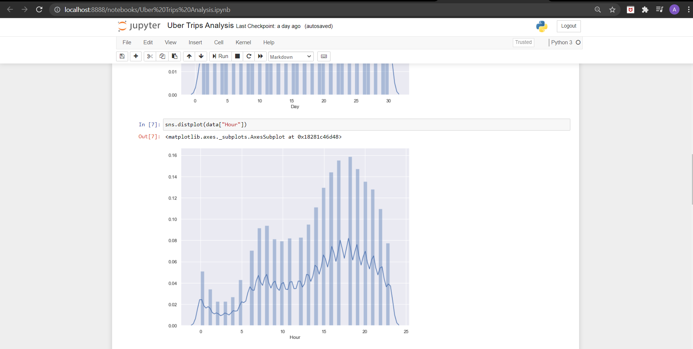
Analyze the Uber trips according to the hours
Uber trips decreases after midnight and then start increasing after 5 am and the trips keep rising till 6 pm such that 6 pm is the busiest hour for Uber then the trips start decreasing.

Slide 12
According to the hourly data, the Uber trips decreases after midnight and then start increasing after 5 am and the trips keep rising till 6 pm such that 6 pm is the busiest hour for Uber then the trips start decreasing.
As the mostly working time is from morning to evening time so Uber use will definitely increase during that time between 5:00 am to 6:00 pm.
Now let’s analyze the Uber trips according to the weekdays:

Slide 13
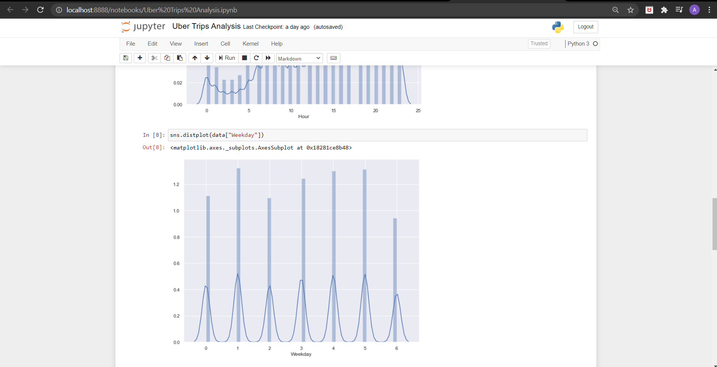
Analyze the Uber trips according to the weekdays
On Saturdays, the Uber trips are the lowest and on Mondays, they are the highest.

Slide 14
In the above figure we can conclude about Sunday that on Sundays the Uber trips are more than Saturdays so we can say people also use Uber for outings rather than for just going to work.
On Saturdays, the Uber trips are the lowest and on Mondays, they are the highest.

Slide 15
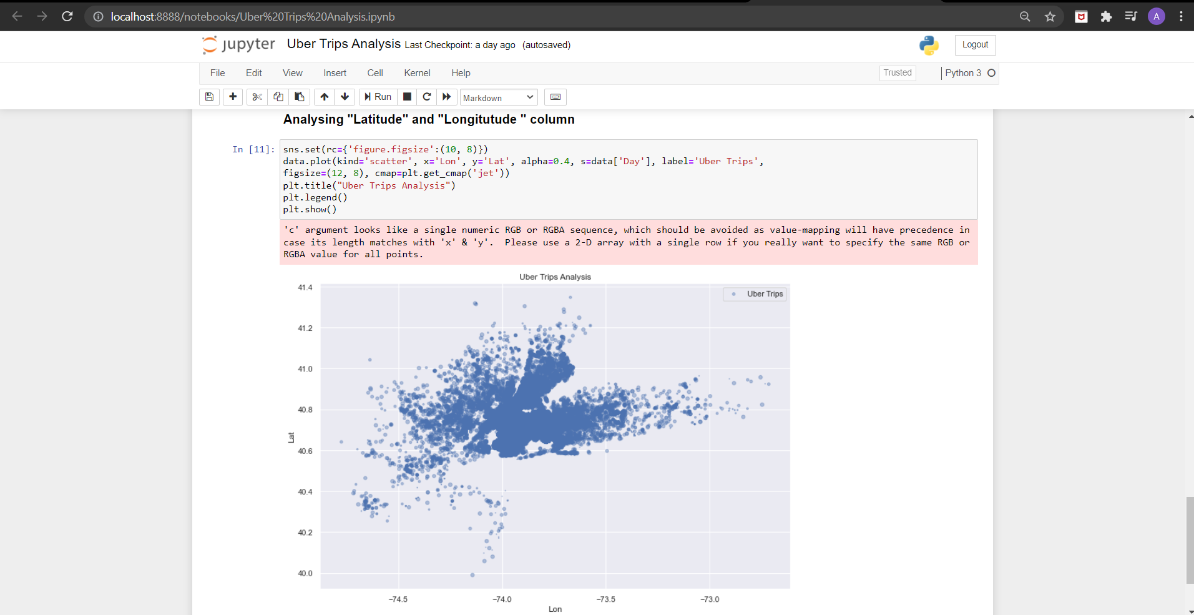
As we are having the data about longitude and latitude so we can also plot the density of Uber trips according to the regions of the New Your city

Slide 16
SUMMARY OF OUR ANALYSIS
So this is how we can analyze the Uber trips for New York City. Some of the conclusions that I got from this analysis are:
Monday is the most profitable day for Uber
On Saturdays less number of people use Uber
6 pm is the busiest day for Uber
On average a rise in Uber trips start around 5 am.
Most of the Uber trips originate near the Manhattan region in New York.

Slide 17
Now we add the user feedback to the dataset so that we do Sentimental Analysis on that.

Slide 18
We take some random feedbacks of user in the text document and load it in our jupyter notebook.
Make a list of all the feedbacks that we taken from the user
Total feedbacks that we have is 101
Now we make the number of feedback equal to the number of observation present in our dataset by repeating the feedback.
Shuffle all the feedback array and add as a new column to the dataset.

Slide 19
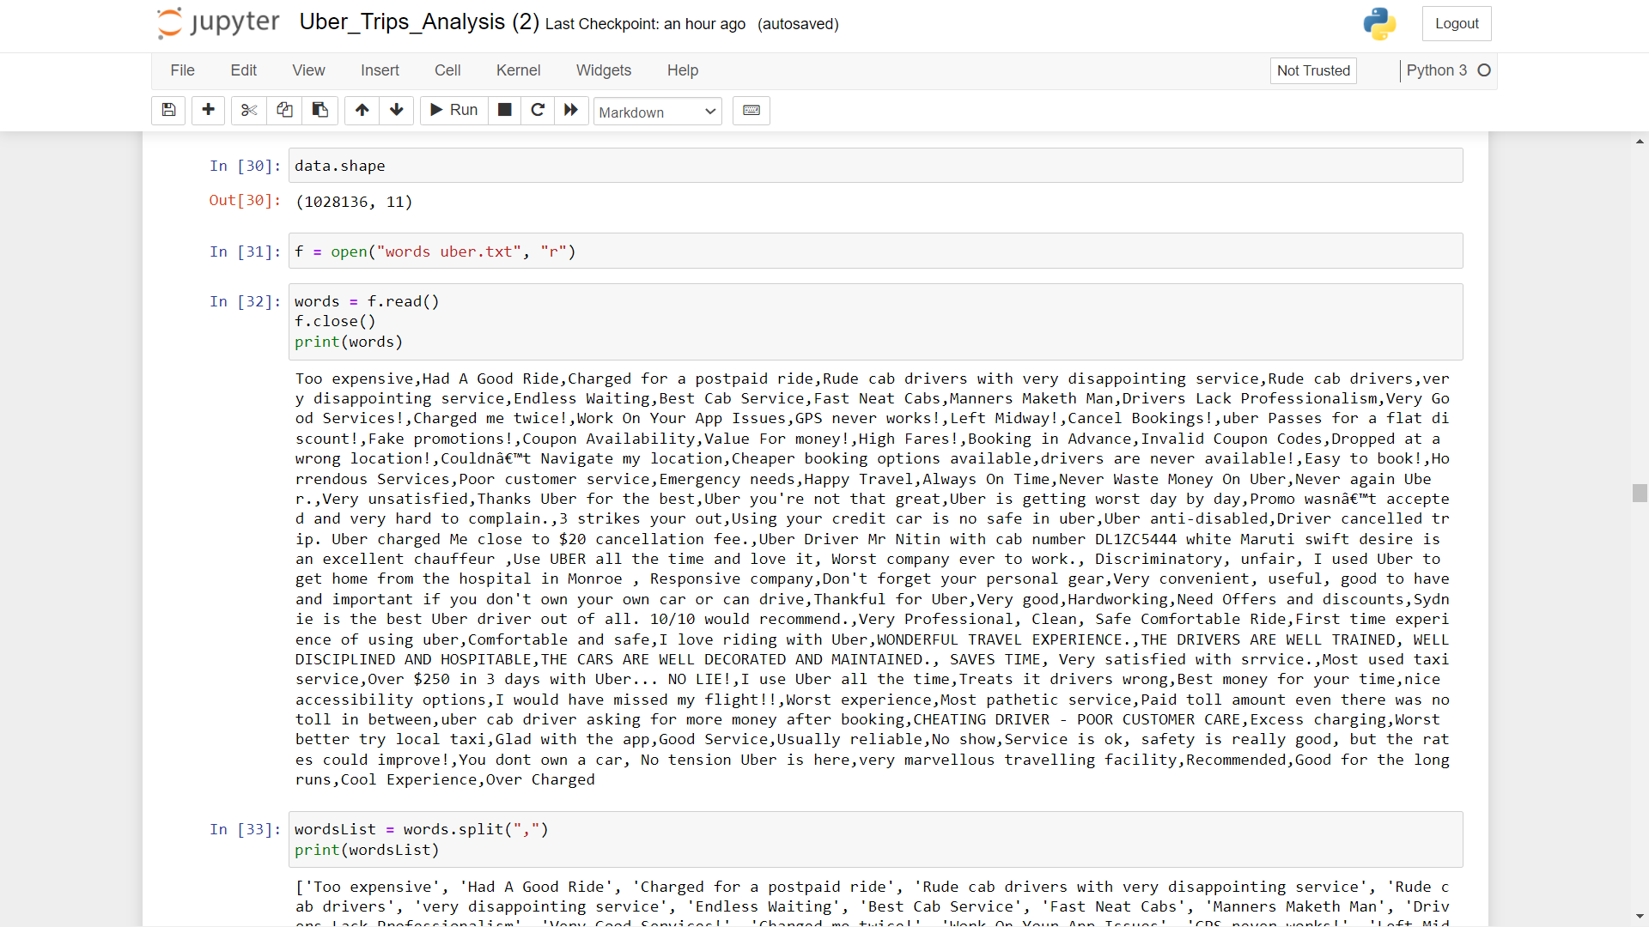
We take some random feedbacks of user in the text document and load it in our jupyter notebook.

Slide 20
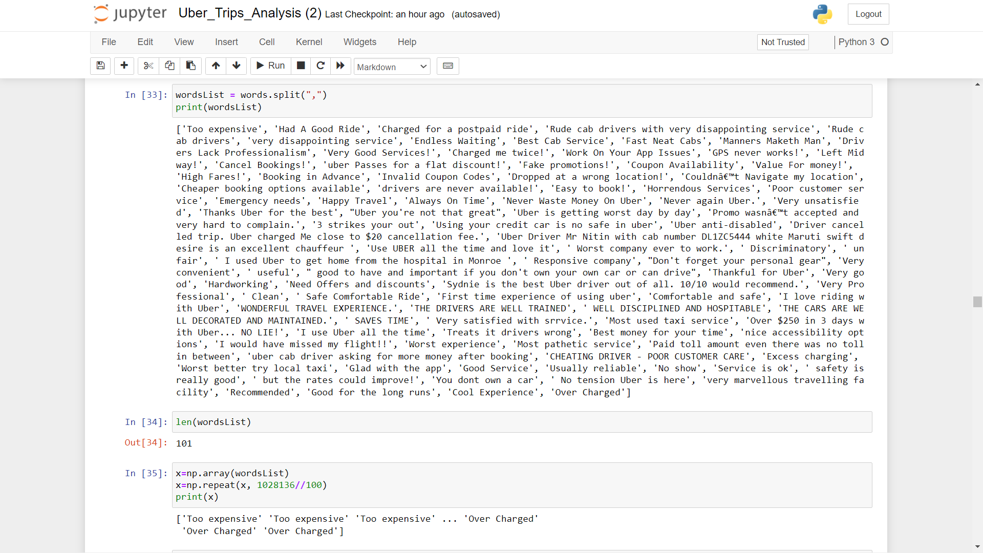
Make a list of all the feedbacks that we taken from the user
Total feedbacks that we have is 101. So we make the number of feedback equal to the number of observation present in our dataset by repeating the feedback.

Slide 21
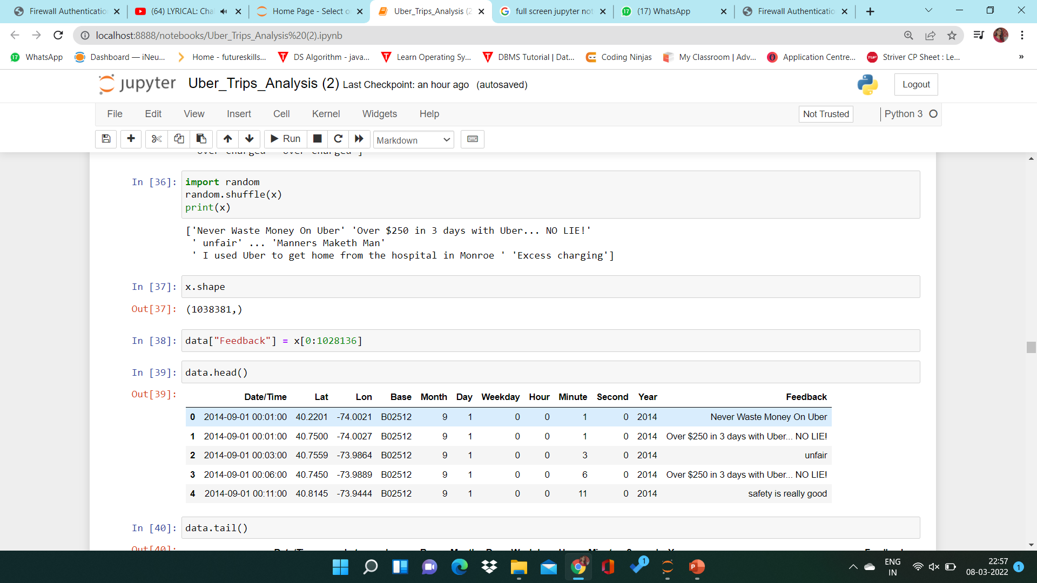
Shuffle all the feedback array and add as a new column to the dataset

Slide 22
We need to perform basic data pre-processing steps like null value imputation and removal of unwanted data.
Let’s see if there are any null values present in our dataset

Slide 23
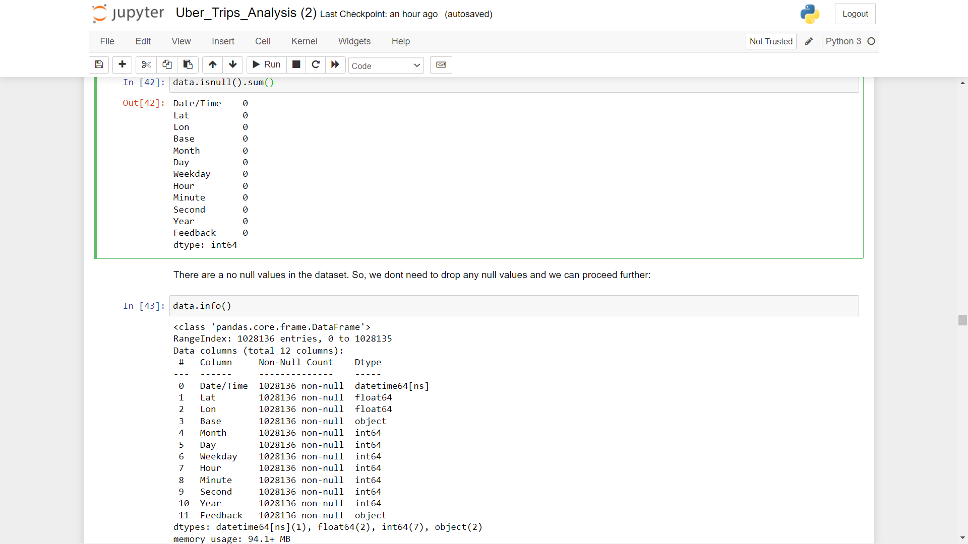
No null values present in our dataset

Slide 24
DATA CLEANING
Lowercase the reviews
In NLP, models treat words like Goat and goat differently, even if they are the same. Therefore, to overcome this problem, we lowercase the words. Here, I am using the lower() function available in Python for converting text to lowercase:

Slide 25
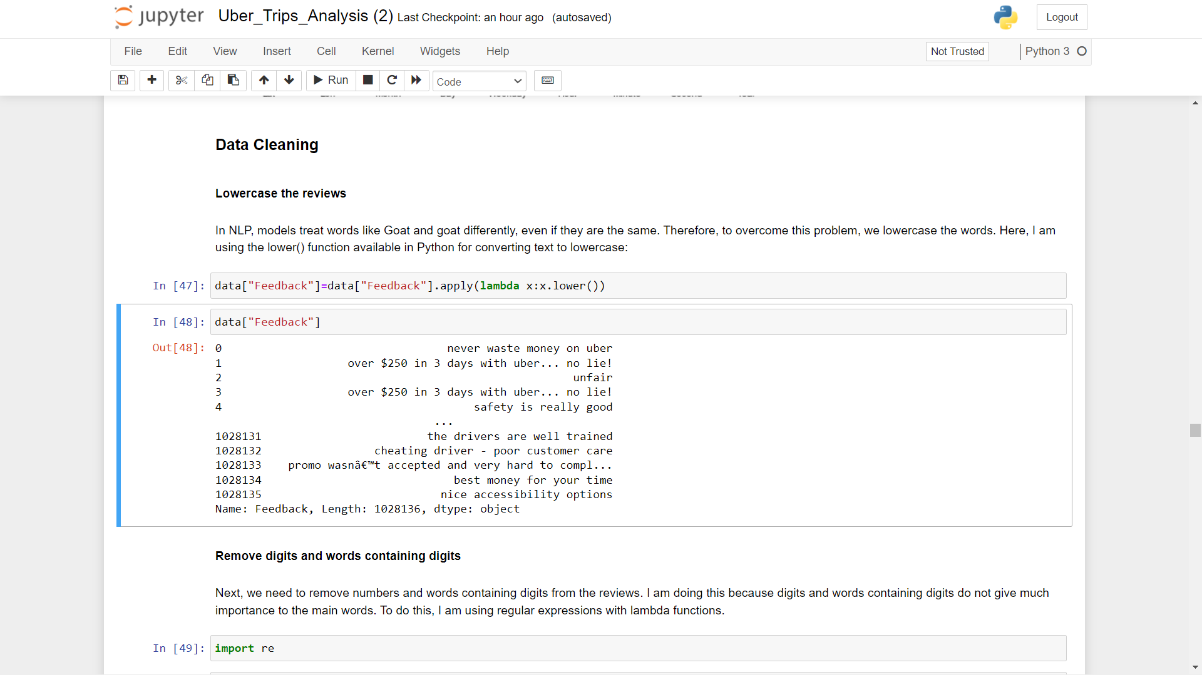
Lowercase the reviews

Slide 26
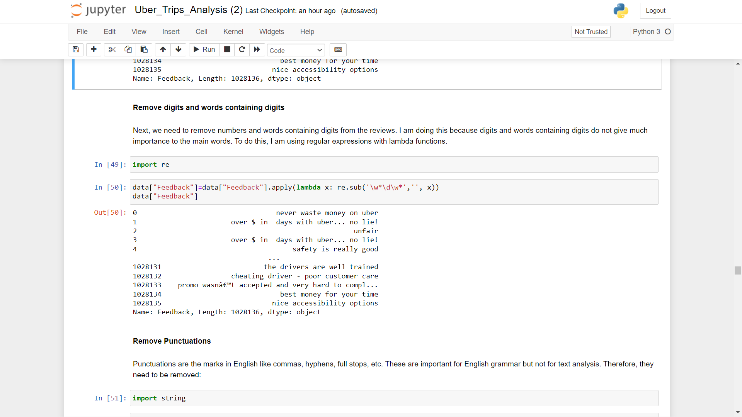
Now we need to remove numbers and words containing digits from the reviews because digits and words containing digits do not give much importance to the main words. To do this, I am using regular expressions with lambda functions.

Slide 27
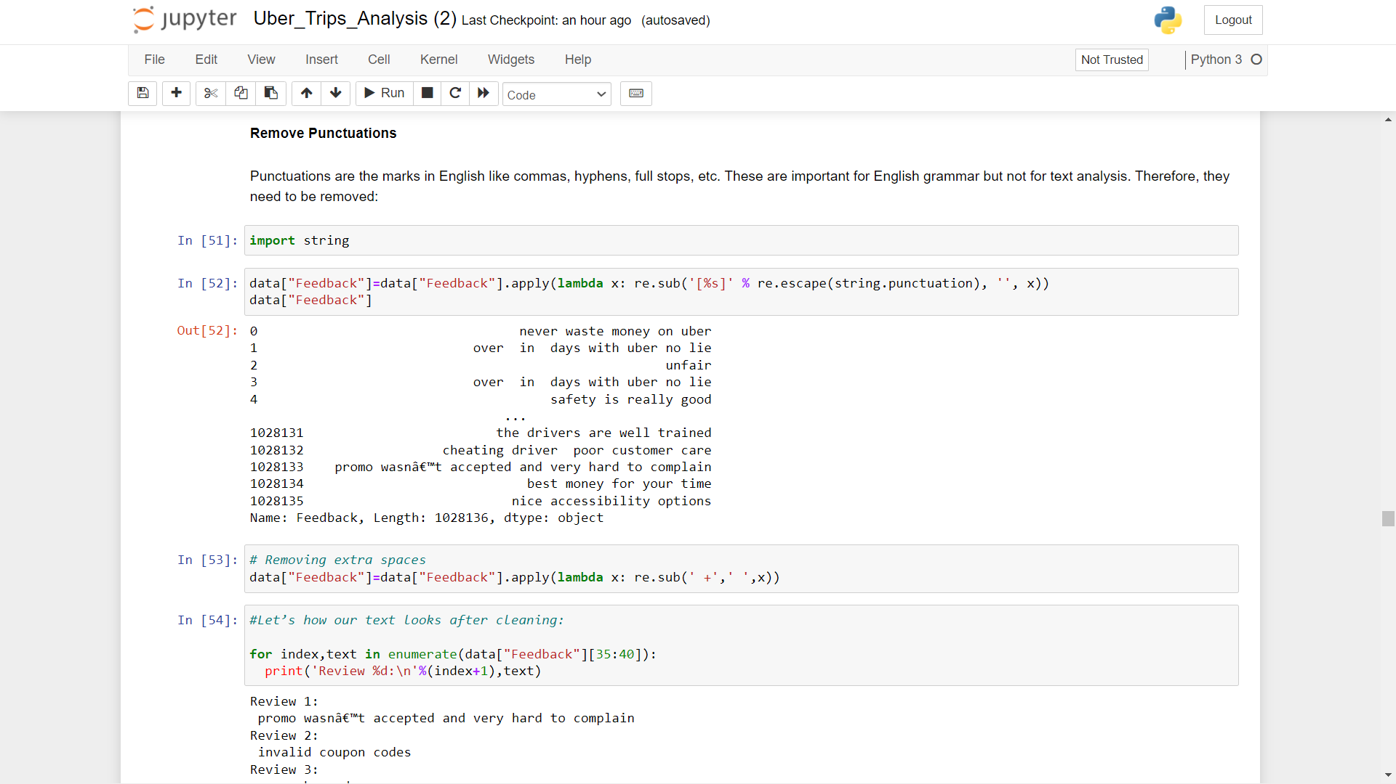
Punctuations are the marks in English like commas, hyphens, full stops, etc. These are important for English grammar but not for text analysis. Therefore, they need to be removed. Also we remove the extra spaces from the feedbacks.

Slide 28
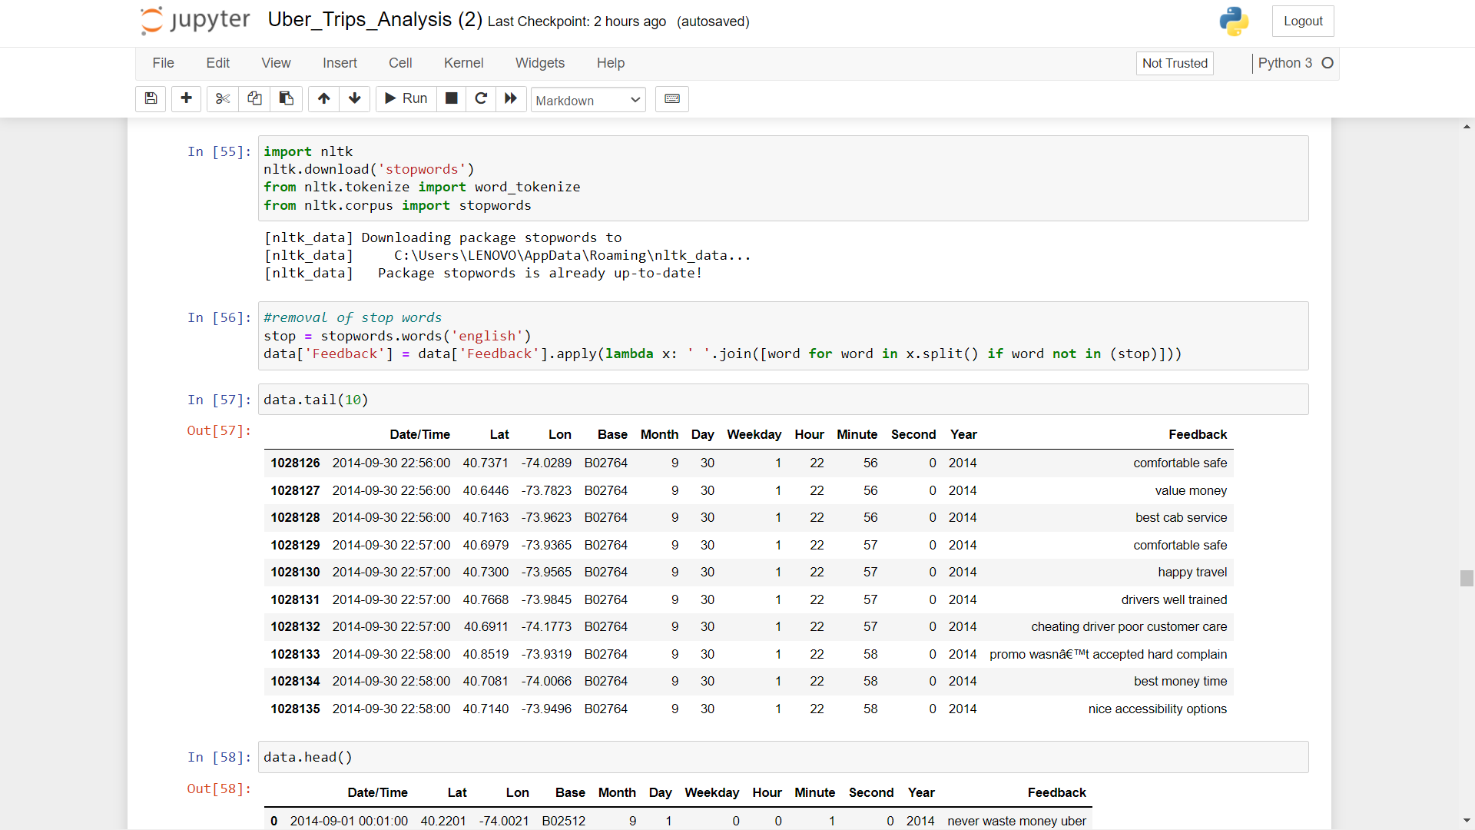
Stopwords Removal

Slide 29
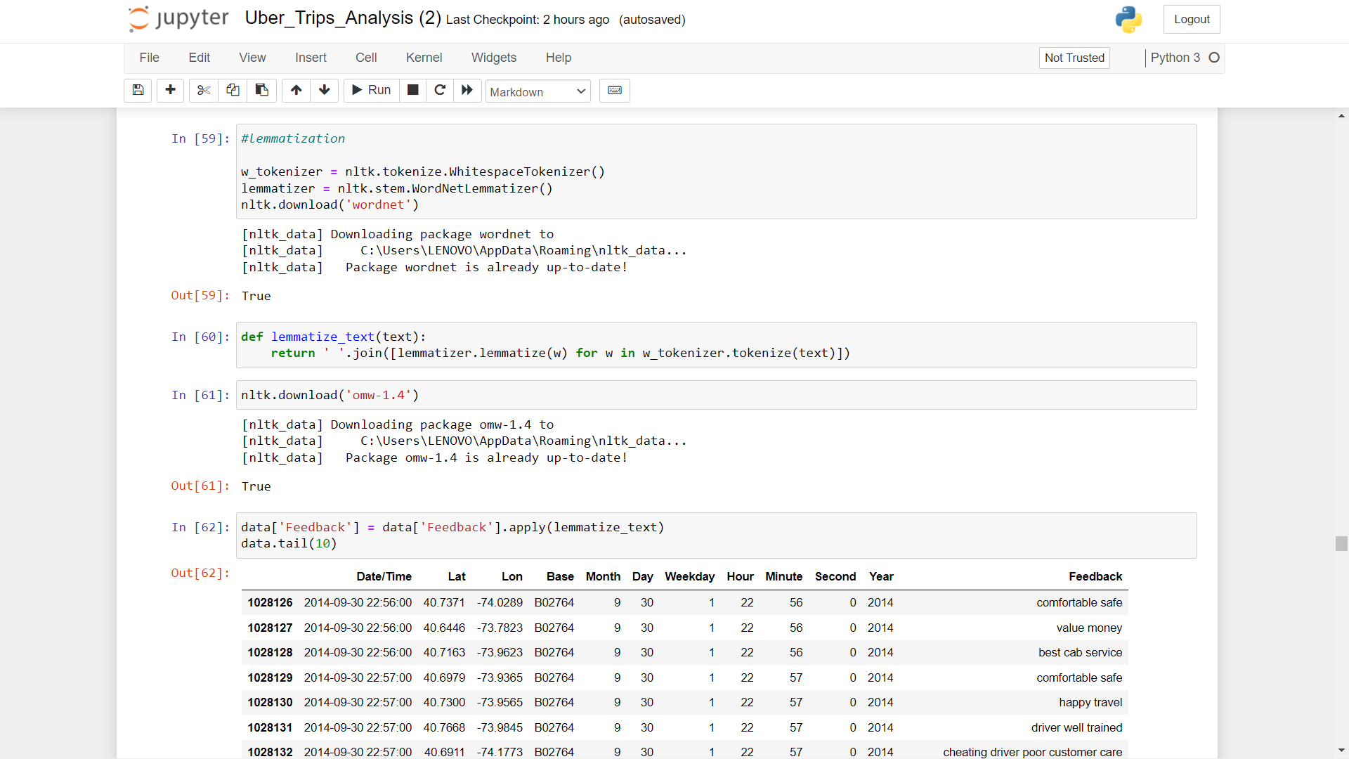
Lemmatization

Slide 30
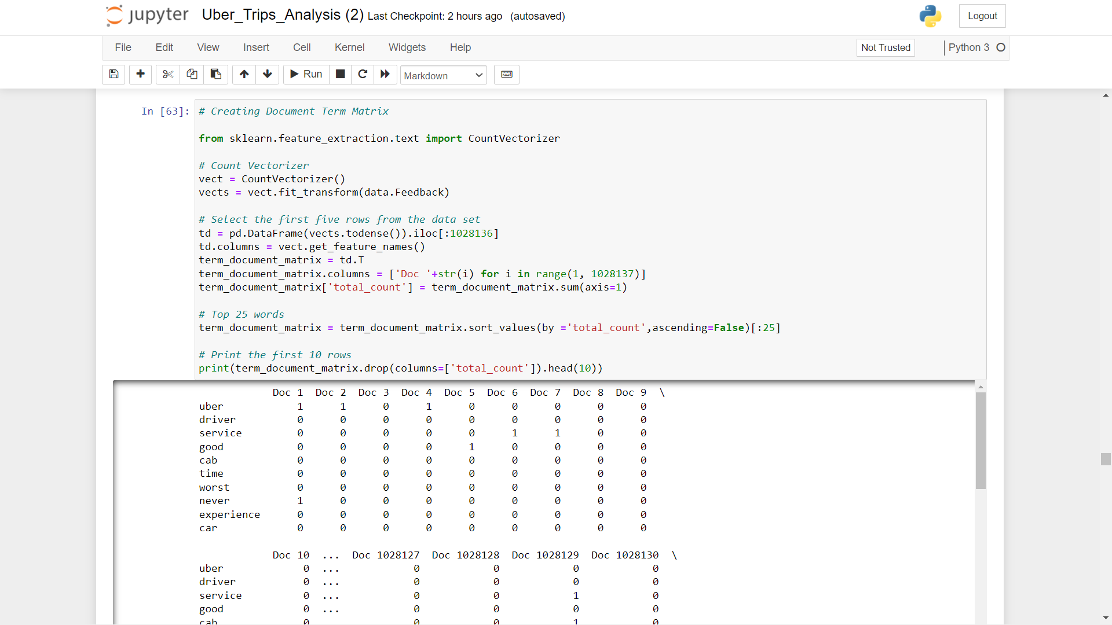
Creating Document Term Matrix

Slide 31
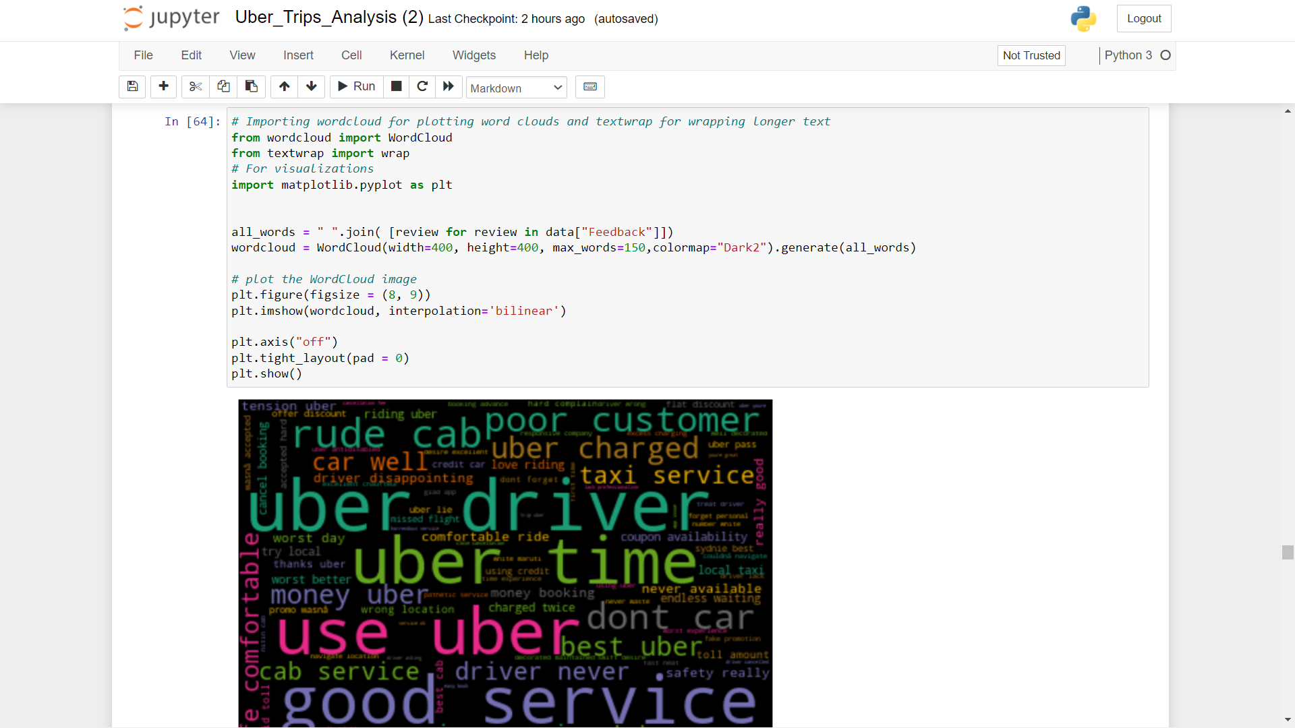
Word Cloud

Slide 32
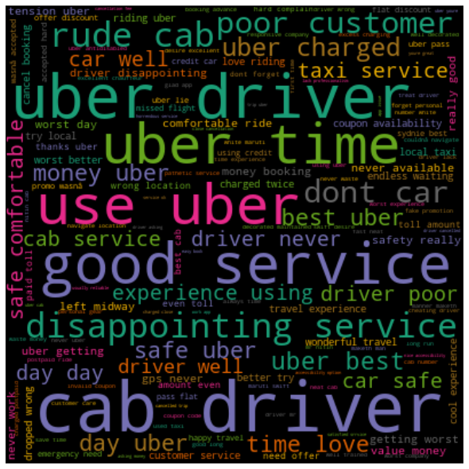
we can see that GOOD,SERVICE,UBER, DRIVER, DISAPPOINTING, LOVE, BEST, CHARGED are the most frequently occurring words for almost every ride. This means that users are loving rides from Uber and found using them a great decision. They also found them easy to use.

Slide 33
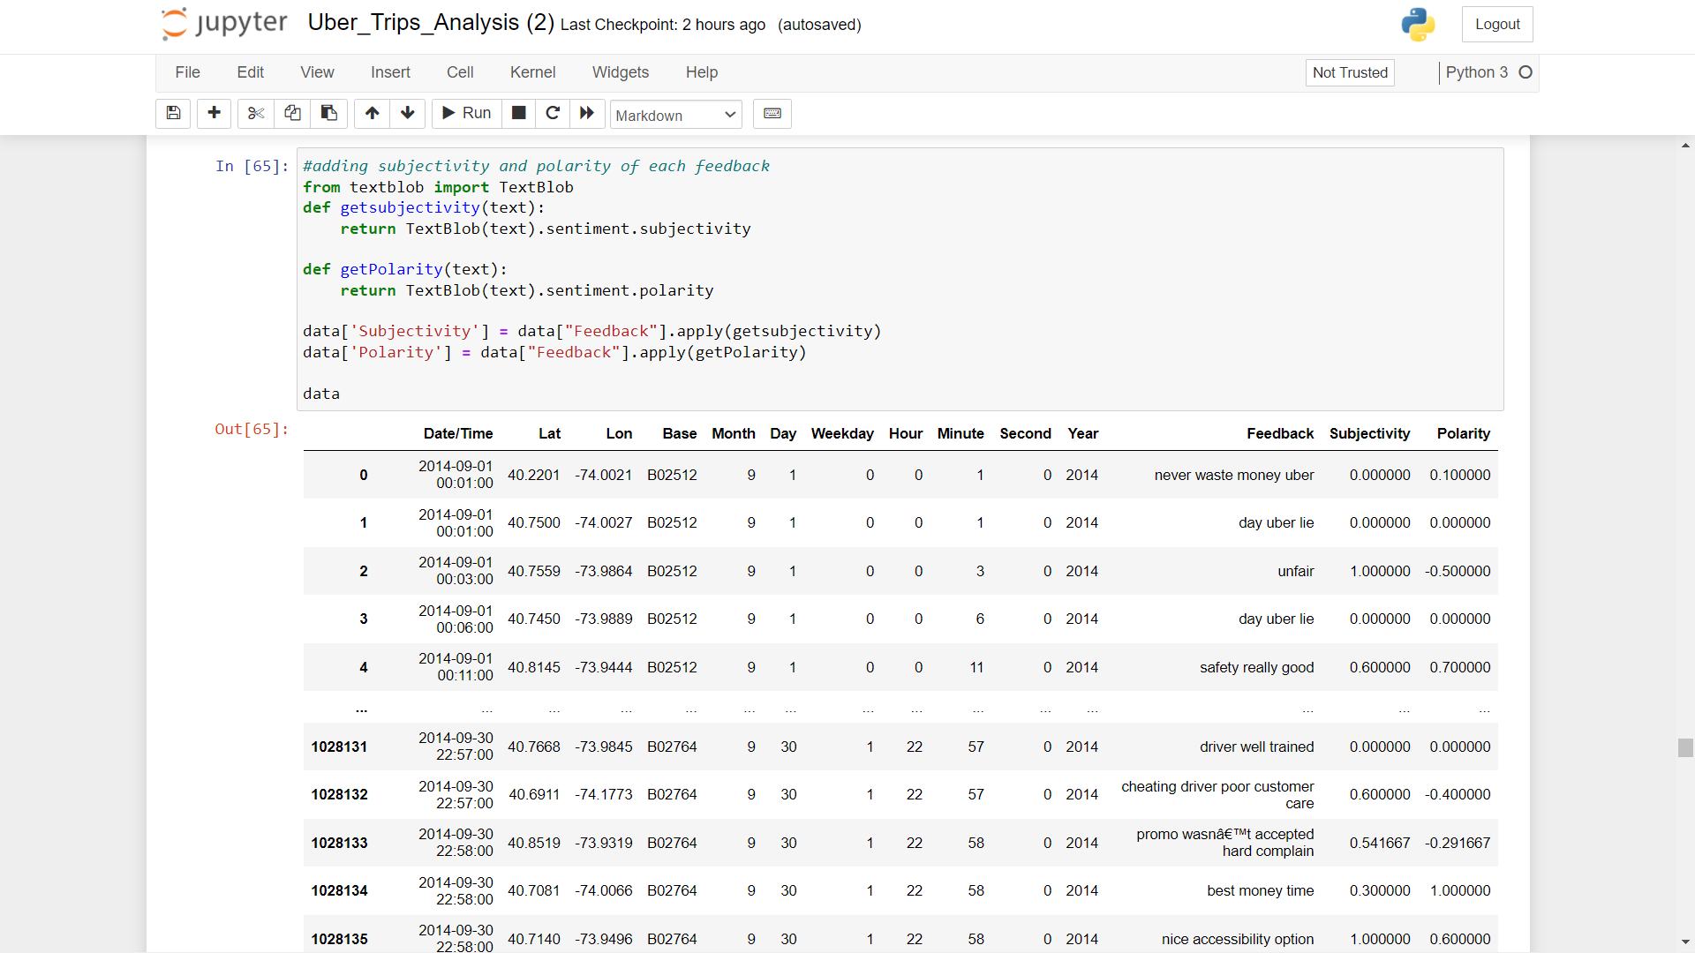
Adding subjectivity and polarity of each feedback

Slide 34
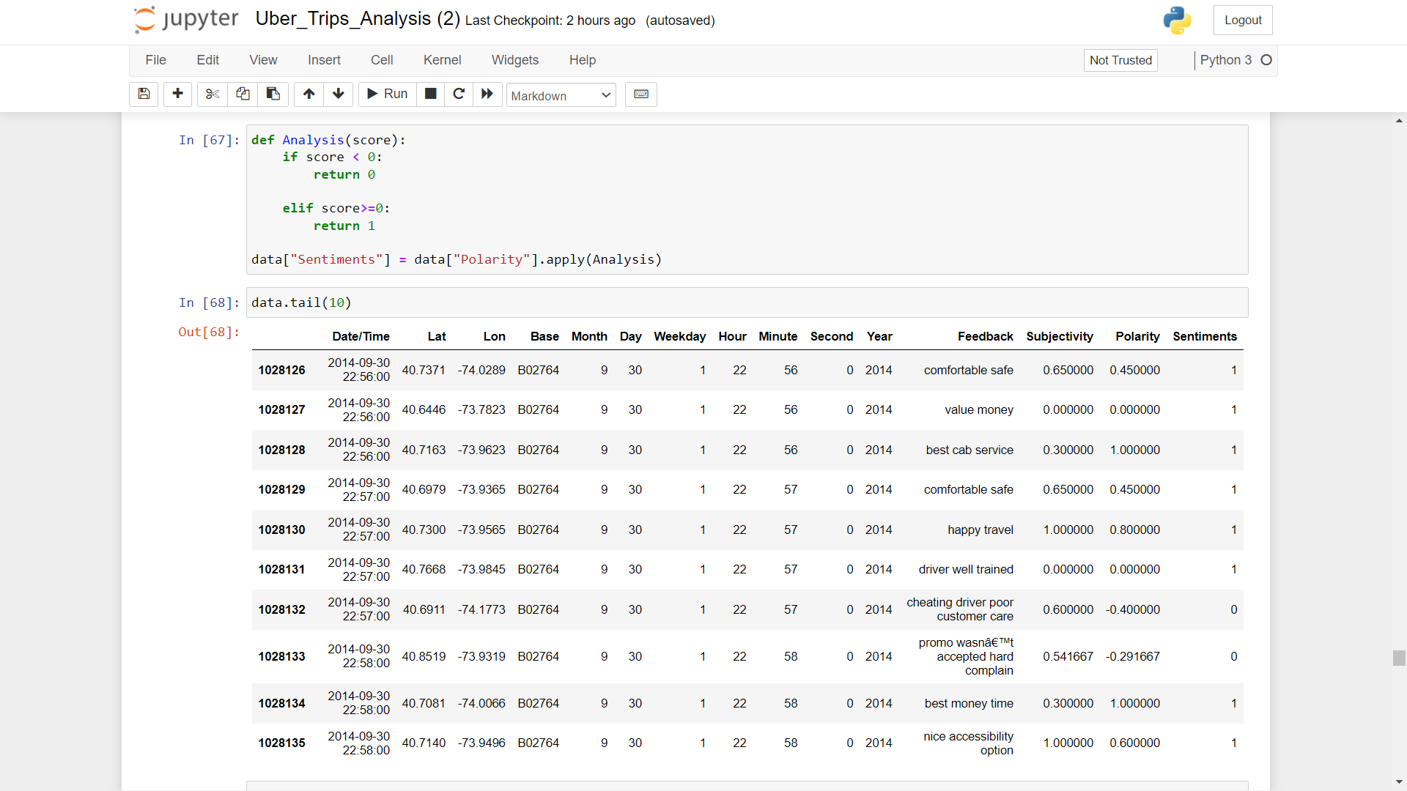
As we have the polarity scores for each feedback, we can start to compute positive and negative analysis of the feedback.

Slide 35
THANK YOU

